Slide 1
Lecture 10
Social Media and its Impacts on Society

Slide 2



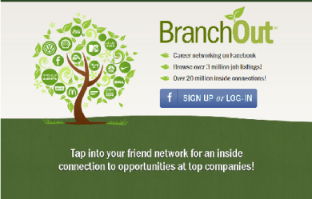



What Is Social Media?
Use of web-based technologies allowing the creation and exchange of user-generated content. Blending of technology and social.

Slide 3

What is social media?
“The “social” in social media implies a conversation. The difference between social media and the TV is that with the latter, viewers seldom engage with the programme-makers of the show that they are watching. Only in very recent times have programme makers expanded into the world of social media. Think X-Factor.

Slide 4
What is social media?
The Central Office of Information (www.coi.gov.uk) said the following in its 2009 publication “Engaging through Social Media”:
  Social media is a term used to refer to online technologies and practices that are used to share opinions and information, promote discussion and build relationships.
  Social media services and tools involve a combination of technology, telecommunications and some kind of social interaction. They can use a variety of different formats, for example text, pictures, video and audio.
Notes:
http://coi.gov.uk/documents/Engaging_through_social_media.pdf

Slide 5
What is social media?
Social media is different to traditional forms of communication such as through newspapers, television, and film.
Cheap – anyone with access to the internet (for example through public libraries)
Accessible – the tools are easy to use
Enabling – allows almost anyone to do things that previously were only the preserve of well-resourced organisations
The use of the word “Social” implies a conversation. Social media is definitely not about one-way communication to a large audience from big organisations.

Slide 6

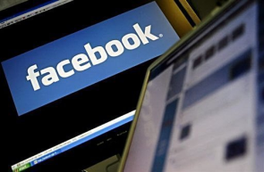
Megatrends 1 – the death of control
The age of control
The age of influence
Big organisations and companies had a monopoly on mass communication and got used to controlling the message
Anyone literate with an internet connection can self-publish for free
Hard to control, can only influence

Slide 7

Megatrends 2 – Fewer gatekeepers
One to many
Many to many
Manage the gatekeepers
One-way, broadcast model.
Managing reputation = managing the media.
Less reliance on media: people get information direct from the source, and from each other.
New-style comms must reach beyond media to a complex interactive model.

Slide 8
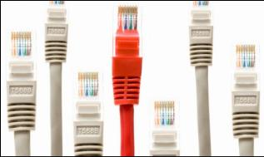

Megatrends 3 – Fragmentation
A few centralised channels
A huge cloud of interaction
People got most information from a handful of news media.
Organisations could efficiently manage (or at least monitor).
Conversations are distributed wherever people form opinions: blogs, social networks, YouTube
Separate provider for the content, and the platform for the content

Slide 9


Megatrends 4 – New web landscape
Push communications
Pull communications
Web as distribution channel
Web as community
The Web was a channel for pushing out information.
Sites were static e-brochures.
The Web was utilitarian. People felt neutral about it.
Now, people spend most time on interactive social media.
The social web is informal, immersive and emotive.

Slide 10
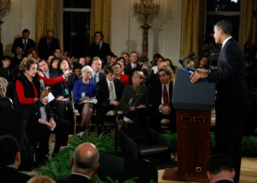
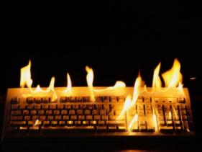
Megatrends 5 – New journalism
Ordered
and
predictable
Messy and opinionated
The world of press releases, news conferences and interviews was well ordered.
Journalists knew the rules of the game and were predictable.
Balance, professionalism, accountability
Huge and distributed.
Everyone can report.
Each sets his/her own rules.
No obligation to be balanced.
Complicated recourse for inaccuracy.
Opinion dominates content.

Slide 11



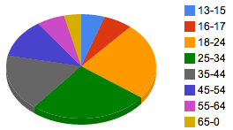
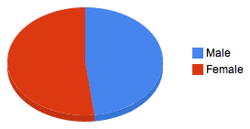
How big is social media in the UK?
10 million UK accounts
> newspaper sales
5% of users write 75% of tweets
30 million+ accounts
Almost half the UK population
Notes:
FB as of Feb 2012 at http://www.clicky.co.uk/2012/02/uk-facebook-statistics-february-2012/
Twitter as of May 2012 http://www.guardian.co.uk/technology/2012/may/15/twitter-uk-users-10m

Slide 12
Social Media Impact
Social networks are moving towards payments on those platforms (eg, Facebook or using Bitcoins)
Payments (especially mobile) are making connections with social networks
  similar to how PayPal revolutionized industry
Social Media can quickly and positively or adversely affect company reputation

Slide 13



Social Media Impact
Linked In: ww.linkedin.com
  100mm users worldwide, 44mm US
Facebook: www.facebook.com
  175mm users worldwide
Twitter: www.twitter.com
  200mm users worldwide

Slide 14
That’s great for the industry, but why am I utilizing Social Media?
Industry knowledge.
  Almost impossible to keep up with all industry publications, becoming connected helps pinpoint hot issues.
Building a personal brand.
  Keep your contacts and maintain knowledge even when changing companies or careers, develops a more comprehensive skill set.
Becoming more effective at networking.
  A large network helps you connect to people even when you can’t help them personally.
Networks should expand beyond core business contacts and companies

Slide 15
Social Media Circles
Payments industry uses
  LinkedIn
  Blogs/Discussion forums
  YouTube
  Lesser Extent: Twitter and Facebook
    However, Facebook has just launched Branch Out
      Professional networking using FB’s reach

Slide 16
LinkedIn
Build your network:
  Stay in touch with current and former peers
  Create community, expand contact lists and introduce connections
Showcasing skill set:
  publishing your resume or establishing expertise for potential clients or employers to view
Work your network, make yourself visible:
  Join groups, gather relevant information, participate in discussions, receive industry updates as they occur
Find targeted people with a specific skill sets:
  for hiring or informational/networking purposes

Slide 17
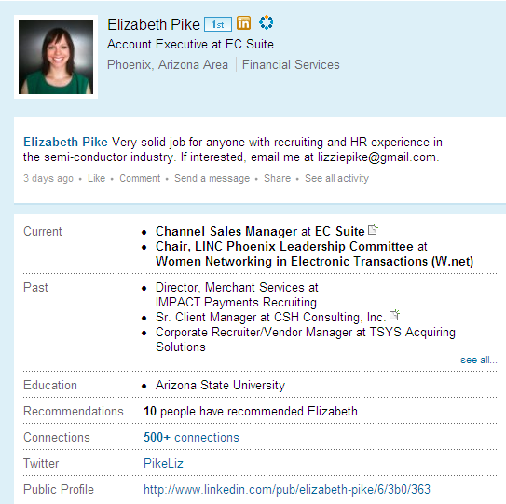


Slide 18
LinkedIn
JOB SEARCH: Utilized to find jobs, people and business opportunities recommended by someone in one's contact network – levels 1,2,3
TALENT SEARCH: Employers can list jobs and search for potential candidates
NETWORKING RESOUCE: Members can review circle profiles of to determine which of their existing contacts can introduce them to people they want to know
PERSONAL-PROFESSIONAL BRANDING: Users can post their own photos and view photos of others to aid in identification
INDUSTRY UPDATE RESOURCE: Register to follow companies to get notifications and relevant information
INFORMATION PORTAL: Users can bookmark (profiles, jobs, etc.) to return to for future reference

Slide 19
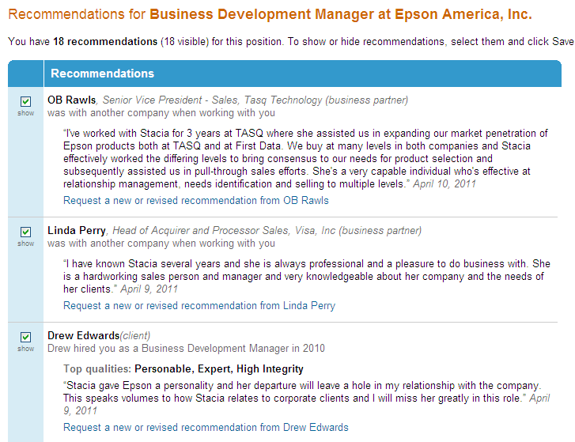

Slide 20
Maximizing LinkedIn
Strive for 100% completeness on profile and keep updated (new skill sets, new company)
Continue to reach out, make connections, or reply to conversations –this pops up on your connection’s activity feed
Post events or new products/information
Follow companies, join and create group
Helpful for industry info, adding contacts to network and all groups have a job posting capability

Slide 21
Marketing your Profile
Include a LinkedIn link on your signature
Ask for recommendations after completing business
Integrate business tweets
Optimize your profile
Focus on developing a quality network

Slide 22
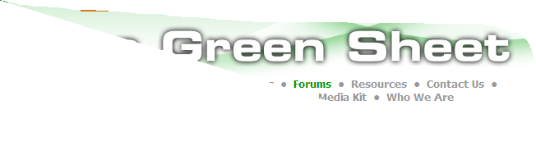

Blogs and Discussion Forums
Receive real time industry updates
Search for new product releases
Expand marketing tools for customer base
Reach new clients
Follow and engage in industry discussions
Serves as a ‘classifieds’ page or open source link

Slide 23
You Tube
Showcase products:
  Compare speed between dial up and wireless terminals
Launch new marketing campaigns for companies, act as a commercial for company
Demos for new products/services
Build personal-professional brand

Slide 24
Twitter
Micro blogging site
Sharing of industry information/updates, usually through sharing links
  Can be useful in following new companies and their technology
Receive up to date info through following active users
Conversation starter
Forum to create company buzz
  External campaigns or contests

Slide 25
Facebook
Becoming an important marketing strategy to increase brand awareness and customer loyalty
  i.e. “LIKE” button
Facebook has wider reach but more casual than LinkedIn
Mixed audiences can become tricky
  Introducing Branch Out

Slide 26

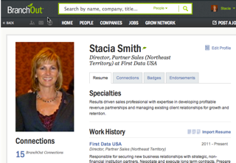
http://branchout.com/about/productTour

Slide 27
Social Media:
Differentiating Your Unique Brand
If you are in a mid-size or larger company, your company probably has an integrated marketing social media business plan, but YOU are also your own brand
How can you most effectively utilize social media in your life?

Slide 28
Enhance Social Media with Cross Links
Helps contacts, customers and potential clients find you and keep you as a source for information
Tells search engines (like Google or Bing) that your social profiles are all related –\
  pre-emptively occupies Google Page 1, making it more difficult for negative press to float to top
Syndicates content—
  Reduces the need to create new content for every site daily

Slide 29
Tips to Enhance Social Media Platforms
If utilizing Facebook for professional reasons, best to create two accounts –one linked with professional, and one personal and private
Can cross link: eg social media icons on website, blogs that link to LI, Facebook, Twitter, LinkedIn can integrate Twitter feed
Participate in conversations about your industry, can set up reminders via free tools to flag keywords (industry, competitor names) –Hootsuite, GoogleAlerts, TweetDeck, Socialmention.com

Slide 30
Integrating Social Media
Choose the platforms that will enhance your business initiative
  you don’t need to join every site, and it’s useless to join if you aren’t interacting.
Understand the site’s culture and/or rules
  sometimes unspoken
Stay relevant and top of mind
  Follow through on commitments
  Thank others for helping you
  Do what you say you will, and thank others for helping you

Slide 31
Types of social networkers
• Alpha Socialisers – (a minority) people who used sites in intense short bursts to flirt,meet new people, and be entertained.
• Attention Seekers – (some) people who craved attention and comments from others,often by posting photos and customising their profiles.
• Followers – (many) people who joined sites to keep up with what their peers were doing.

Slide 32
Types of social networkers(conti.)
Faithfuls – (many) people who typically used social networking sites to rekindle old friendships, often from school or university.
• Functionals – (a minority) people who tended to be single-minded in using sites for a particular purpose.
Source: Ofcom Social Networking Sites research, September-October 2007

Slide 33
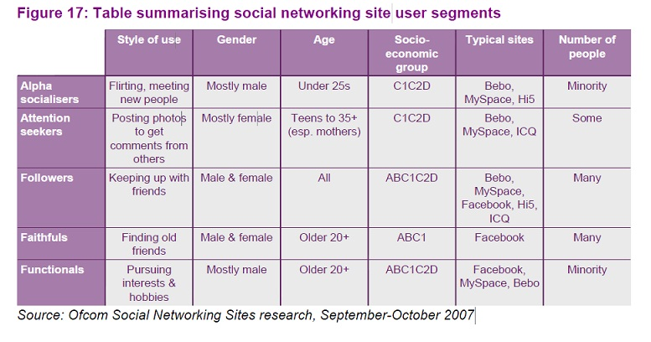

Slide 34
Privacy concerns
Social networking sites provide privacy options but users are generally unaware or tend to ignore such concerns
Stalkers, terrorists, ill-doers, con-artists could benefit from such issues
Recent scandals-England :MI-6’s director’s wife puts up photos of family on facebook.
Facebook’s controversial decision to make visible relationship actions to entire social group

Slide 35
Security issues
Recent malware exploiting social networks
  Malicious Banner ads
  Adware
  Phishing attacks
  Customizable scripts

Slide 36
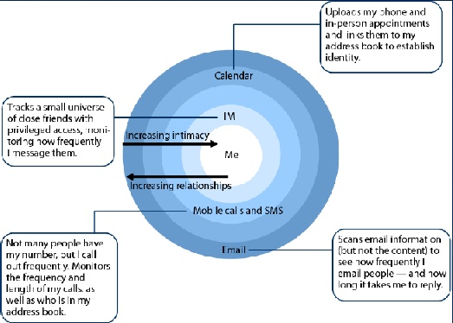
Social and Psychological issues
Increasing relationships but decreasing intimacy

